Slide 1
AGILE
DEFENSE
A NEW WAY OF WAR

Slide 2
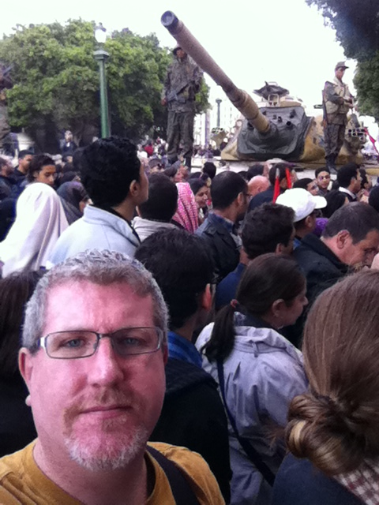
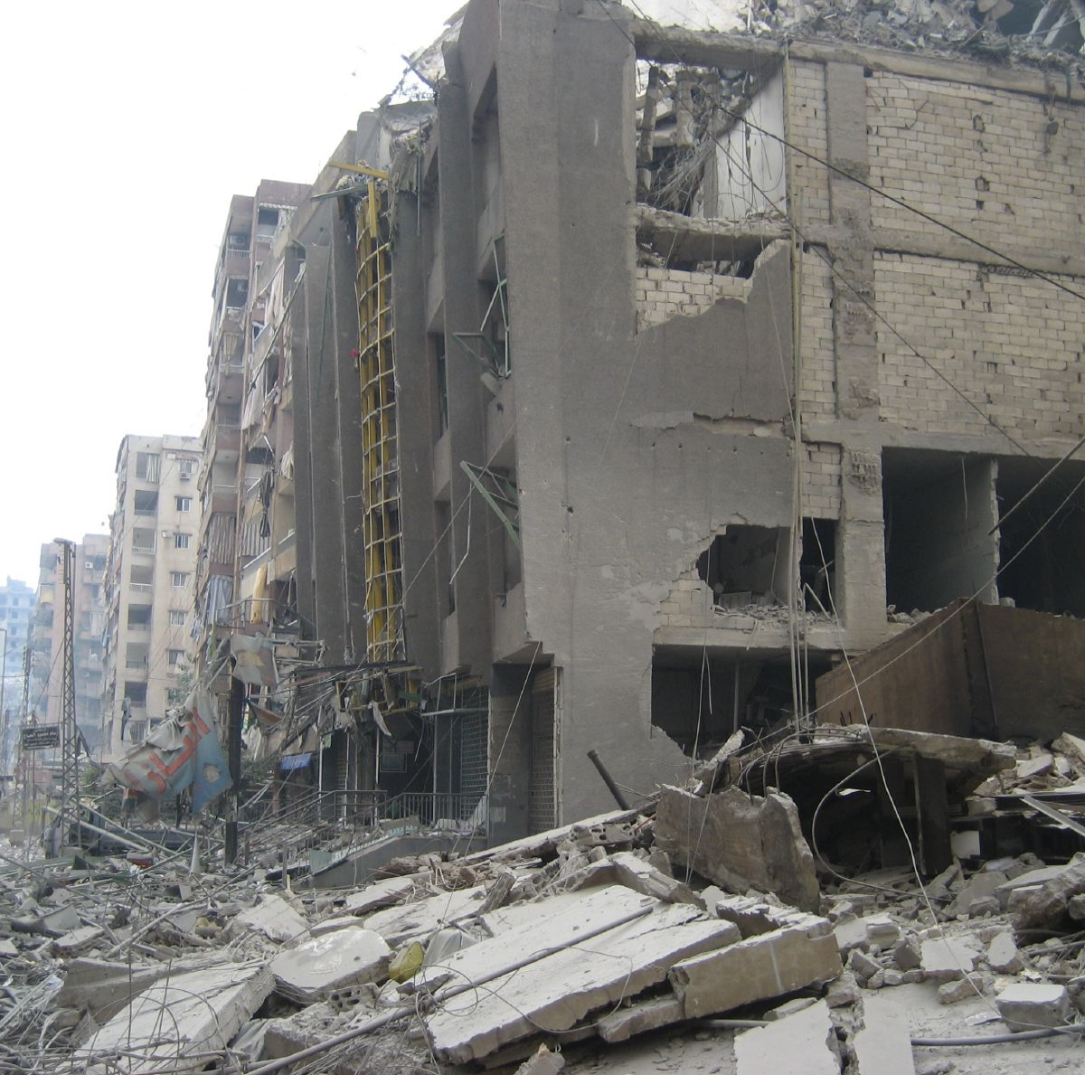
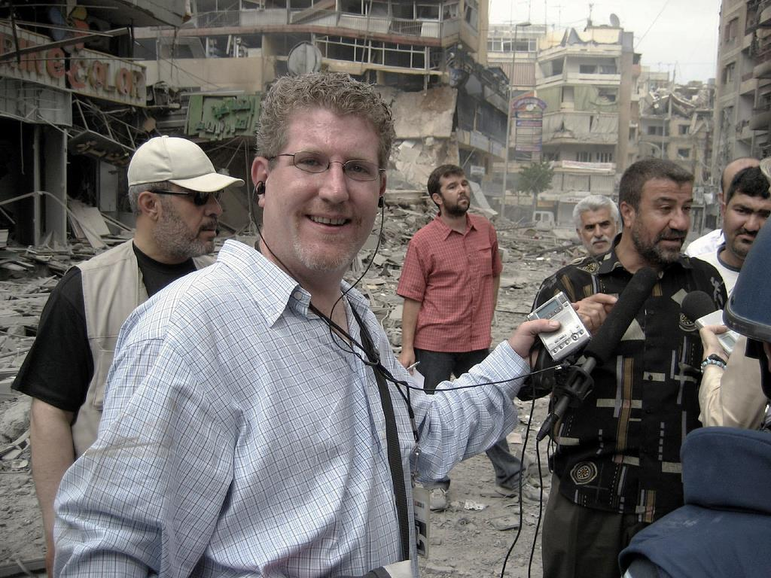
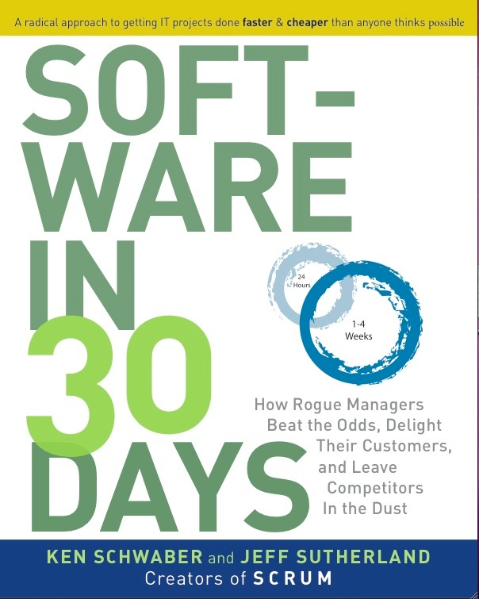
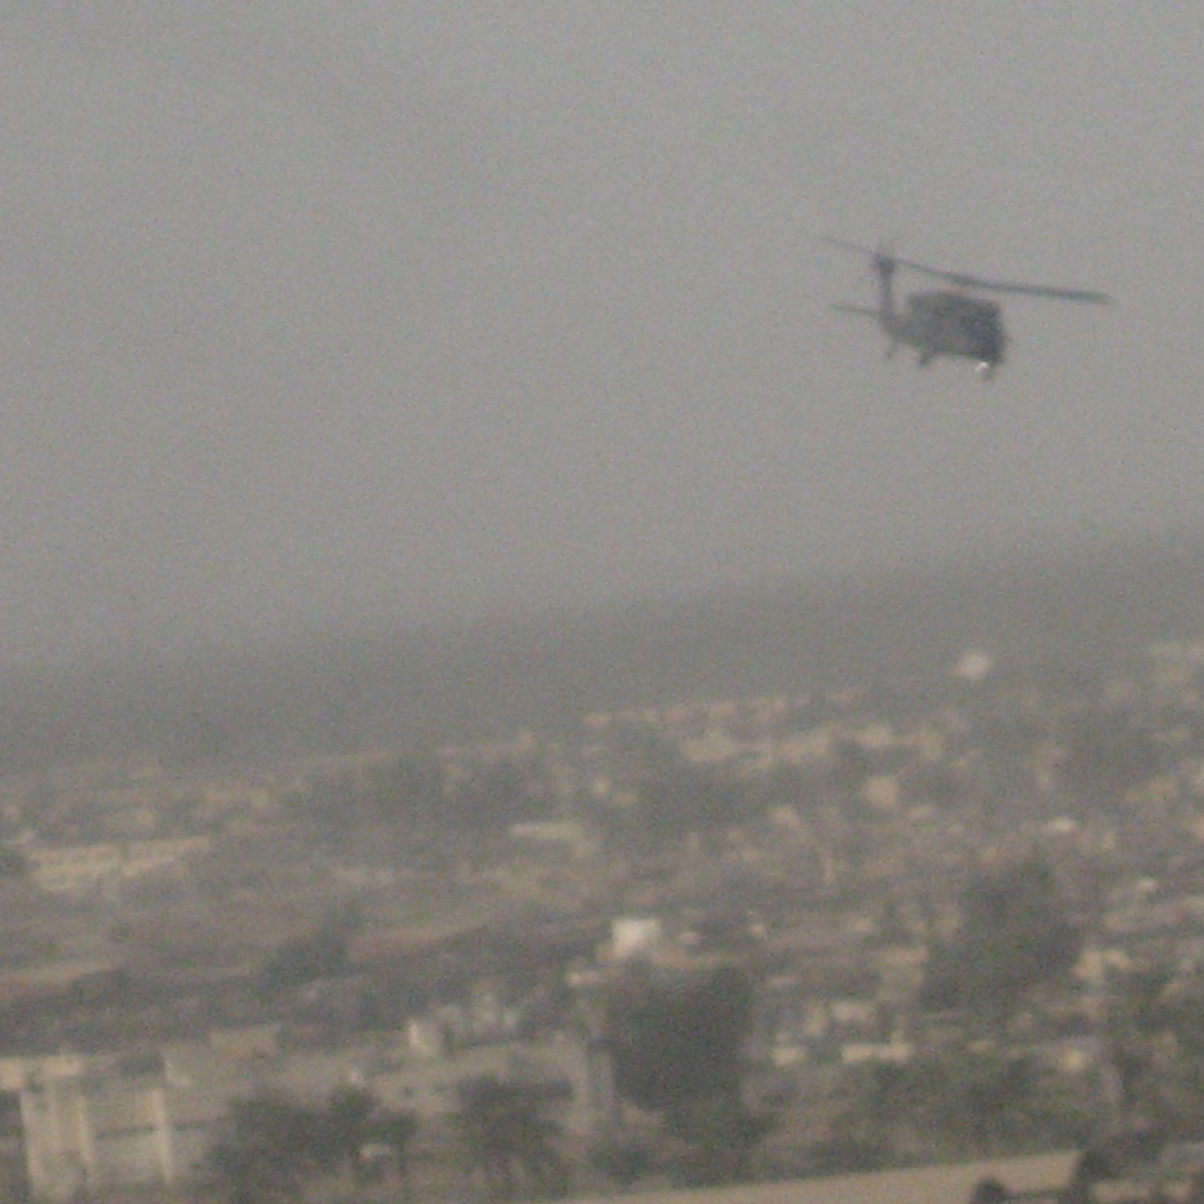
J.J. Sutherland
Chief Content Officer, Scrum Inc.
Co-Author, Scrum: The Art of Doing Twice the Work in Half the Time, The Power of Scrum, Software in 30 Days. Award winning journalist. Former Baghdad Bureau Chief, Kabul Bureau Chief, Cairo Bureau Chief, Beirut Bureau Chief, Deputy Managing Editor, Executive Producer, Producer-at-Large, Blogger, Pentagon Correspondent, NPR.

Slide 3
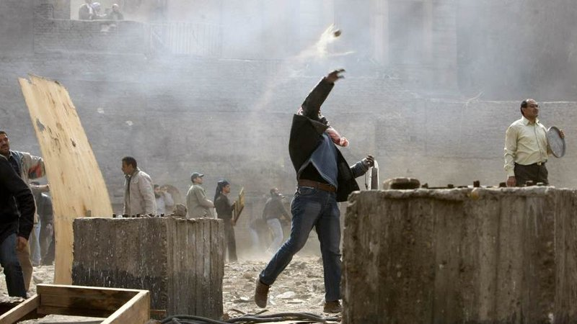
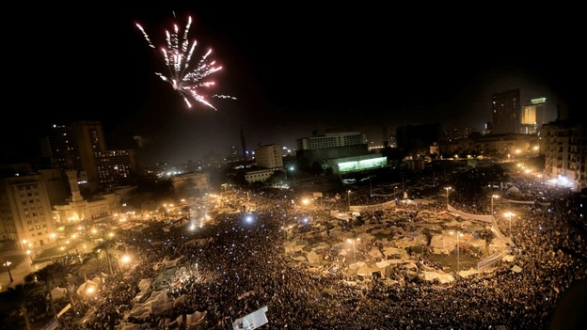
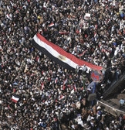
TAHRIR SQUARE
CAIRO, EGYPT
1/25/11

Slide 4
Short Iterations. Continuous Improvement
Guerilla Scrum
12 HOUR SPRINTS
RETROSPECTIVE TWICE A DAY
RESPONDING TO CHANGE
28 deliverables each Sprint
1:00 pm/Midnight
More than half of work in process overtaken by events
SMALL TEAM
AUTONOMOUS
PURPOSE
Four correspondents. Two producers. Fixer. Translator.
Unreliable phone and internet. Only comms by Satellite.
Generational, epochal change.
AWARDS
Overseas Press Club Award, Peabody Award, Edward R. Murrow Award

Slide 5
The New New Product Development Game
Takeuchi and Nonaka, Harvard Business Review, January 1986
NASA
Type A – Isolated cycles of work
Type B – Overlapping work
Fuji Xerox
Scrum Project Management
Type C – All at once
Honda, Canon, 3M, …

Slide 6
GANNT CHART
Paying people to lie to you

Slide 7
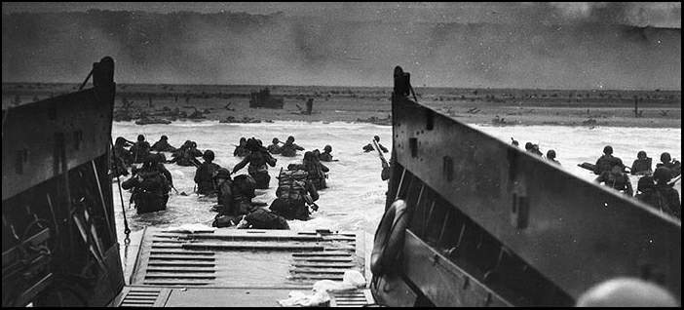
“PLANS ARE WORTHLESS. PLANNING IS EVERYTHING!”
PRESIDENT DWIGHT D. EISENHOWER

Slide 8
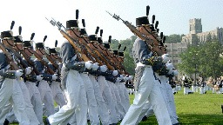
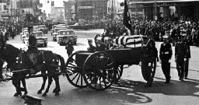
MAKE WORK VISIBLE
Real time self-organization

Slide 9
BURNDOWN CHART
Constant, small adjustments in real time.

Slide 10
OODA LOOP
How the “Mad Major” John “Forty Second” Boyd Saw Aerial Combat

Slide 11
A FRACTAL ENTERPRISE OF SMALL TEAMS
Optimal Team Size is 4.6 People
OBJECT
ORIENTED
ORGANIZATION
Refactor to optimize value delivery
Small steps regularly
Large changes periodically

Slide 12
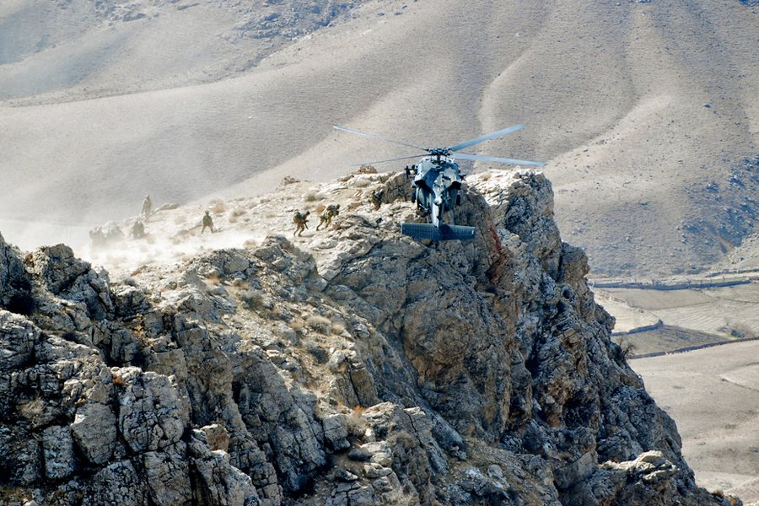
CROSS FUNCTIONAL TEAMS
All the skills needed shared among all the team
Notes:
A typical Army Special Forces “A-team” has twelve people. A team leader, who is a commissioned officer, a warrant officer, a team sergeant (who runs the team in day to day operations), an intelligence sergeant, and two each of special forces weapons, demolition, medical, and communications sergeants. Each team has all the capabilities to carry out their mission from start to finish. And they conduct cross-training across each skill set. They want to make sure, for example, that if both of the medics get killed, the communications specialist can patch up the weapons specialist. Another way the Special Forces operate is that, unlike much of the “regular” military, they don’t separate intelligence gathering and operations planning. There are no handoffs from one team to another where mistakes are might be made. Special Forces don’t want any Challenger disasters. As a result there’s constant communication among the people collecting the intelligence, those planning what to do with it, and those who’ll be going through the door.

Slide 13
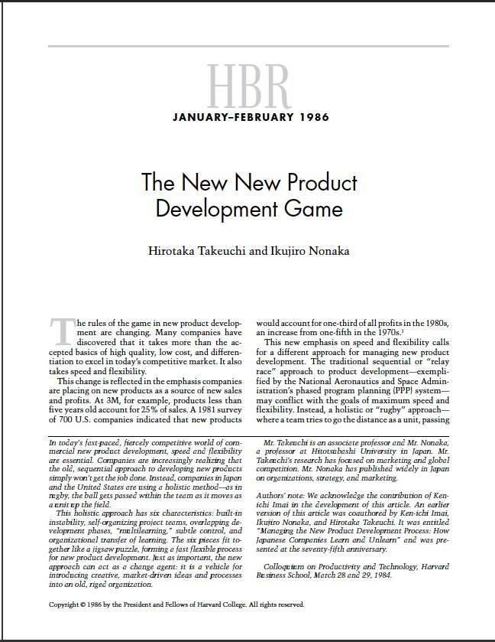
ELEMENTS OF GREAT TEAMS
TRANSCENDENT GOALS
AUTONOMY
CROSS-FERTILIZATION
A challenge. Something that pulls greatness out of them. A mission that has impact. A chance to change the world for the better. An opportunity to make a difference.
Self-directed. Opinions and ideas matter and are taken seriously. Treated like an adult with valuable insight. Able to make decisions on one’s own.
All the skills needed to deliver are on the team. The chance to learn from each other. The chance to teach someone else. Respect for and sharing of skills.

Slide 14
SPECIAL FORCES A-TEAM
rRadical Cross-Functionality
Commander
Asst. Commander
Ops
Asst. Ops and Intel
Weapons
Weapons
Comms
Comms
Medic
Medic
Engineer
Engineer
Commander
Asst. Commander
Ops
Asst. Ops and Intel
Weapons
Weapons
Comms
Comms
Medic
Medic
Engineer
Engineer
Notes:
T-shaped people

Slide 17
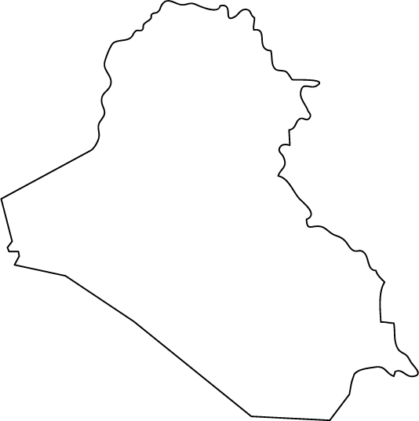
Intelligence
New Targeting
Targeting
Iraq

Slide 18
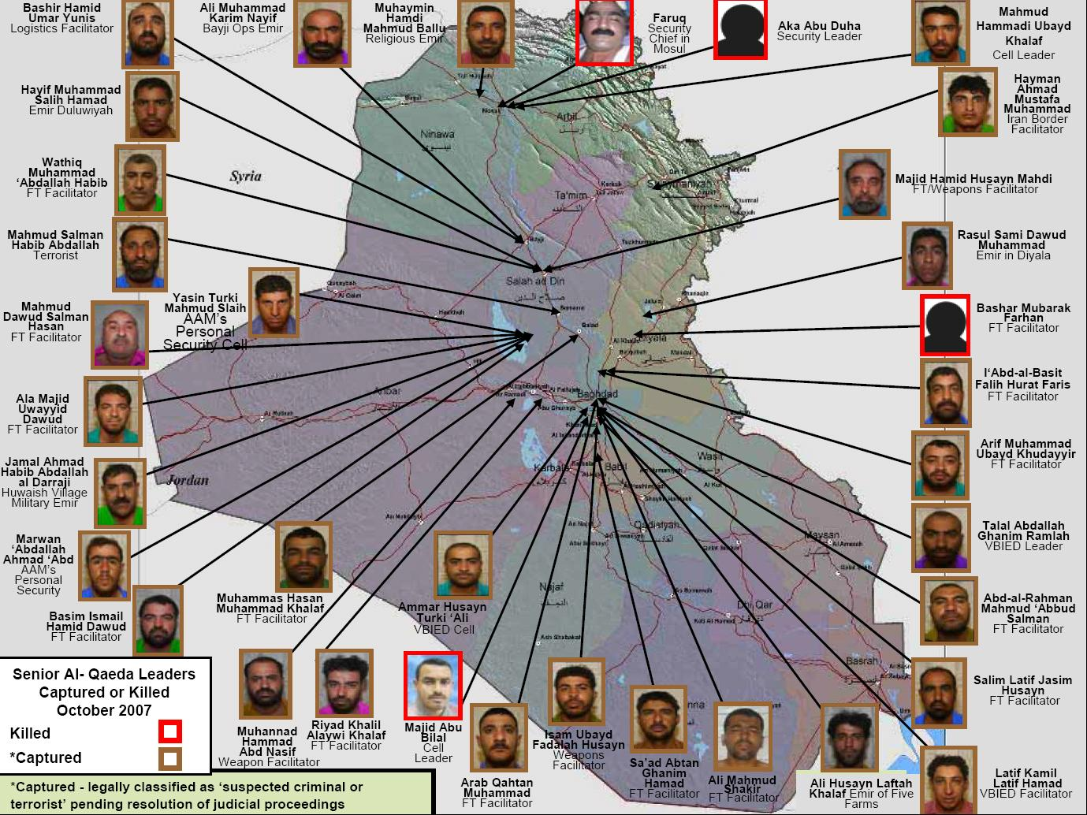
Al Qaeda in Iraq Leaders Captured or Killed October 2007

Slide 19
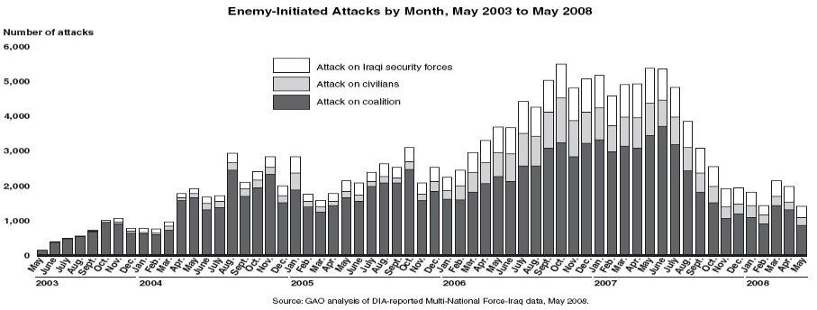
Collaborative Warfare
Impact of a Team of Teams
The interagency teams made it possible to eliminate the organizational seams between the different coalition actors in Iraq, placing an “unblinking eye” on high-value targets. . . . Passing responsibilities between units and organizations represented an “organizational blink” during which momentum slowed and the target might escape.
-Joint Force Quarterly
“One of the true breakthroughs…[Like] the tank or the airplane. The stuff of which military novels are written.
Bob Woodward on 60 Minutes
Notes:
FBI, Treasury, CIA, NSA, Geo Spatial…all in the same room with the SOF.

Slide 21
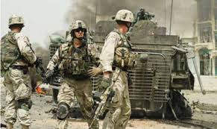
IMMEDIATELY DISBANDED
“. . . as soon as the near-failure in Iraq was averted, bureaucratic support for interagency teams began to decline….one unidentified intelligence agency, began pulling back people and cooperation, believing information-sharing and collaboration had gone too far.”
Secret Weapon: High-value Target Teams as an Organizational Innovation
Institute for National Strategic Studies: Strategic Perspectives, no. 4, 2011
Notes:
Goes back to leadership…this was pushed by the President. IF Petraeus complained, you’d have to answer to the White House.

Slide 22
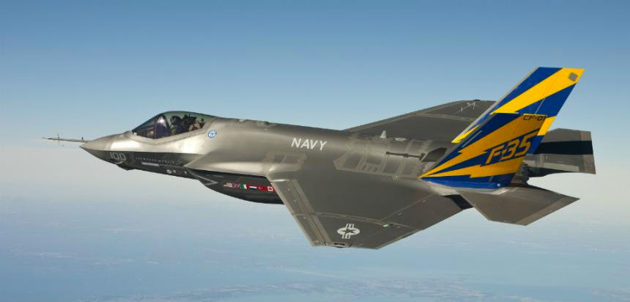
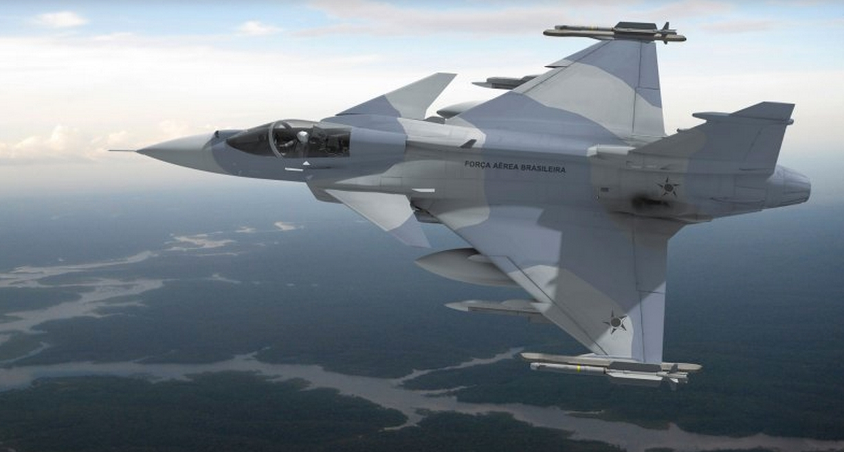
F-35 “Joint Strike Fighter” – Traditional Design
SAAB JAS 39E “Gripen” –
Agile Design
$143 billion over budget
At least another year late (final systems integration)
Cost of Navy F-35C grew from $273 million in 2014 to $337 million by 2015
Cumulative program cost of $15 billion
New iteration of all systems released every 6 months
$43M cost¹ (20% of F-35)
1. According to Jane’s Aviation Weekly, the Gripen is the world’s most cost-effective military aircraft

Slide 23
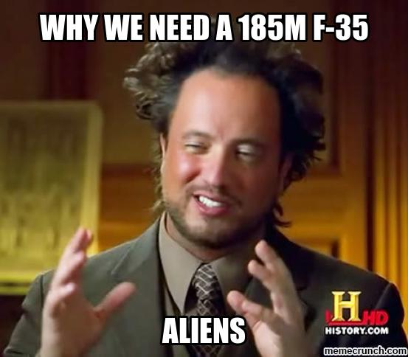
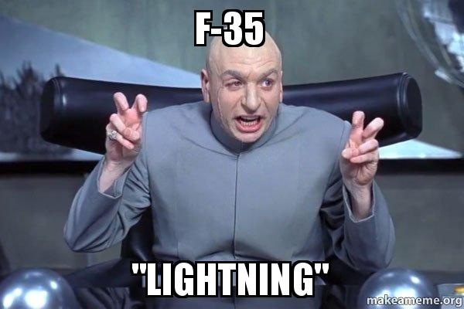
SO EMBARRASSING IT’S A MEME
The F-35 just got crippled by a computer glitch that won't be fixed for at least 4 more years.
Meanwhile, the program's $1.5 trillion projected cost is enough to end world hunger for 50 years ($30 billion/year x 50 = $1.5 trillion).

Slide 24
Saab Gripen Process

Slide 25
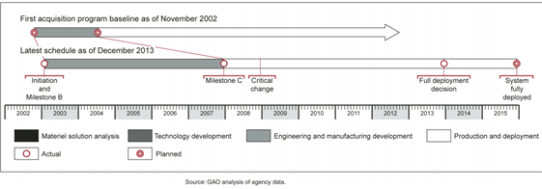
GAO ON MAJOR AUTOMATED INFORMATION SYSTEMS
2014 Aanalysis of 15 projects costing $4.5 Billion
Only 13 of 15 could even provide data
7 cost increased: 4% to 2,233%
4 cost decreased: 4% to 86%
12 dates slipped. 3 by more than 5 years.
ONLY 3 “met system performance targets”

Slide 26
2010 DEFENSE ACQUISTIONS ACT
New Acquisition Process Required- The Secretary of Defense shall develop and implement a new acquisition process for information technology systems…
…designed to include:
early and continual involvement of the user;
(B) multiple, rapidly executed increments or releases of capability;
(C) early, successive prototyping to support an evolutionary approach; and
(D) a modular, open-systems approach.
© 1993-2012 Jeff Sutherland

Slide 27
CIO OF DEFENSE DEPARTMENT: ENABLE AGILE IT
A different approach to project management - Small, dynamic, and empowered teams
Active user involvement to prioritize requirements and provide responsive feedback during development
Roadmaps and architectures align agile increments into larger capabilities
Deliver usable capabilities to users every 6-12 months
Small scoped releases responsive to changes in ops, tech, budget...
Integrated test and evaluation, certifications during development leveraging common test infrastructure, automated tools
Streamlined contracting processes leveraging existing contract vehicles for rapid Task/Delivery Order execution
Leveraging common infrastructure platforms, standards, and interfaces
27
Source: DoD’s CIO 10 Point Plan for IT Modernization
Notes:
This is what Gripen is doing

Slide 28
GAO GUIDANCE ON COMMON CRITICAL SUCCESS FACTORS FOR AGILE
Common Critical Success Factors
Program officials were actively engaged with stakeholders
Program staff had the necessary knowledge and skills
Senior department and agency executives supported the programs
End users and stakeholders were involved in the development of requirements
End users participated in testing of system functionality prior to formal end user acceptance testing
Government and contractor staff were consistent and stable
Program staff prioritized requirements
Program officials maintained regular communication with the prime contractor
Programs received sufficient funding
Notes:
DoD, VA…

Slide 29
THE OLD WAY
Waterfall is not dead

Slide 30
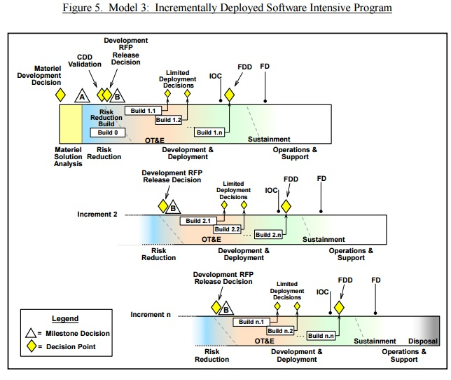
A NEW WAY
Incremental delivery
This model is distinguished from the previous model by the rapid delivery of capability through several limited fieldings in lieu of single Milestones B and C and a single full deployment. Each limited fielding results from a specific build, and provides the user with mature and tested sub-elements of the overall capability
DoD Instruction 5000.02

Slide 31
SEI TECHNICAL NOTE
If the Project Management Office (PMO) is doing a request for proposal (RFP), no matter which phase, ensure that the RFP contains language that allows the use of Agile.

Slide 32
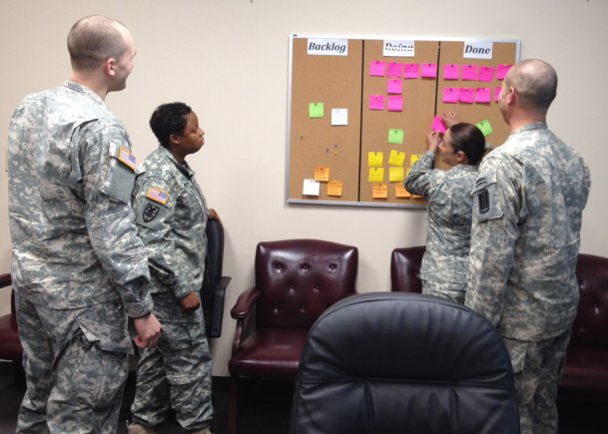
193rd Infantry Brigade - Fort Jackson, S.C.
Trains almost 50% of people entering the service each year
“To date, the brigade has coordinated efforts to turn in hundreds of thousands of dollars in excess equipment, reduced missed medical appointments, which save Moncrief Army Community Hospital thousands of dollars, and leads the way in redesigning the Basic Combat Training field training exercise model to increase Soldier proficiencies.”
- Capt. Jason Horton, Army.mil, 3/26/15

Slide 33
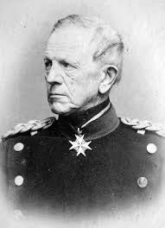
AUFTRAGSTAKTIK
The what matters, not the how.
“‘His Majesty made you a major because he believed you would know when not to obey his orders.’”
Field Marshal Helmuth von Moltke the Elder
Chief of the German General Staff
1857-1888
Commander’s Intent:
“A clear and concise expression of the purpose of the operation and the desired military end state that supports mission command, provides focus to the staff, and helps subordinate and supporting commanders act to achieve the commander’s desire result without further order, even when the operation does not unfold as planned.”
- JP 3-0 Joint Operations
Notes:
Subordinates in the Prussian army were under no obligation to follow inappropriate orders. Moreover, it was an officer’s duty to disregard an inappropriate order. Researcher F. Zilian recounts the experience of one junior officer who had made a tactical error on the basis of his superior’s direction. The officer pointed out to Prince Frederick Charles that his training had stressed that he should treat a superior officer’s order as if it had been issued by the king. The prince is said to have replied: “His Majesty made you a major because he believed you would know when not to obey his orders.”

Slide 34
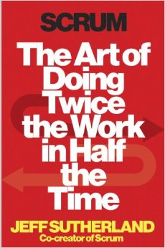
Questions?
“Scrum is mandatory reading for any leader, whether they’re leading troops on the battlefield or in the marketplace. The challenges of today’s world don’t permit the luxury of slow, inefficient work. Success requires tremendous speed, enormous productivity, and an unwavering commitment to achieving results. In other words success requires Scrum.”
General Barry McCaffrey
Available 9/30 from Crown Business
Pre-Order at Amazon or Barnes and Noble

